Slide 1

The Little Seal Bug
Optical Sound Recovery from Lightweight Reflective Objects
By: Raz Swissa
Ben-Gurion University of the Negev
#BHASIA @BLACKHATEVENTS
Notes:
Hello everyone, my name is raz swissa, and I am a security researcher at the cyber labs of ben Gurion university of the negev, in Israel.
And today, I will present the little seal bug, an optical sound recovery from lightweight reflective objects

Slide 2


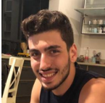
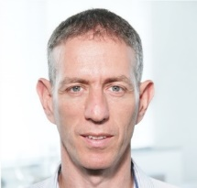
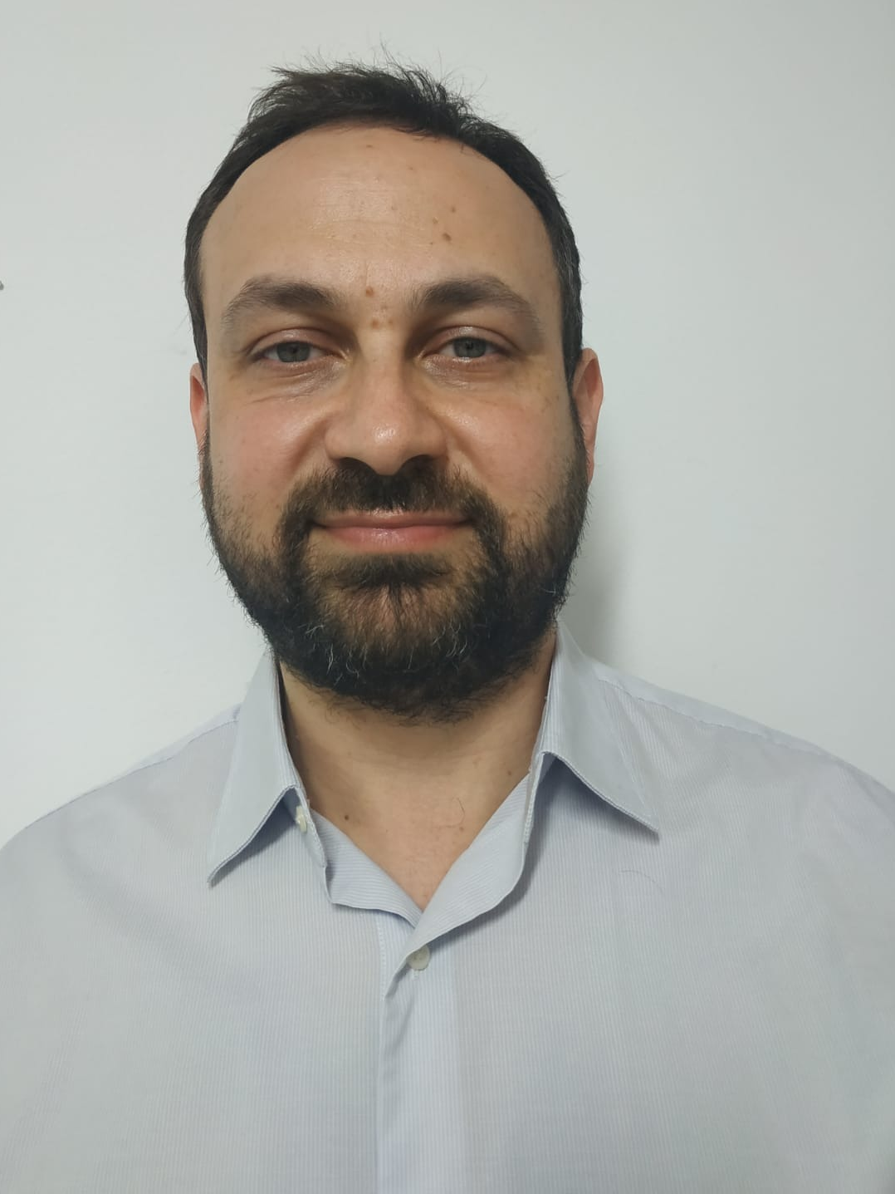

Researchers
Ben Nassi
Raz Swissa
Prof. Yuval Elovici
Dr. Boris Zadov
Notes:
This talk is based on a research that was coordered by myself…

Slide 3
Agenda
Introduction
Related Work
Threat Model
Analysis
Recovering Speech
Evaluation
Takeaways
Q&A
Notes:
This is the agenda for today
We will start with some introduction,
we will review the related work to this paper
We will see the threat model of the attack
Then we will discuss some interesting experiements we did in the analysis
we will discuss on how to recover speech from optical measurments
We will see and hear nice speech recoveries from devices
Then we will review the takeaways of this talk
And hopefully we have some time for q&a

Slide 4

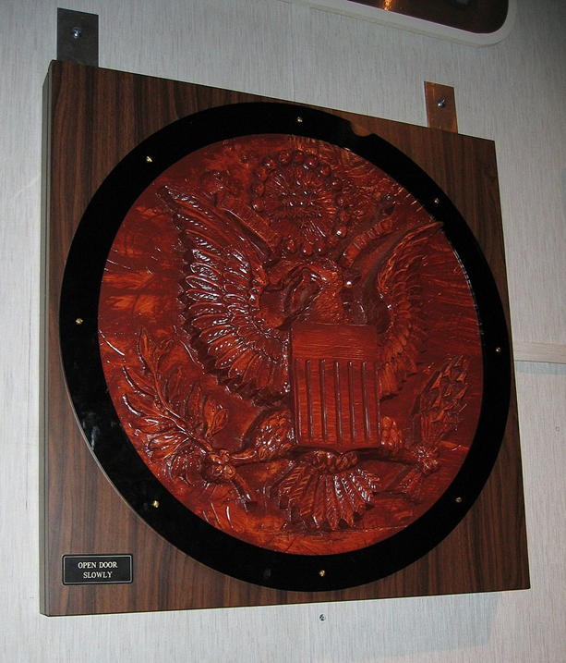
The Great Seal Bug
What do you know regarding the picture presented on the right side of the slide?
Notes:
So first of all, What do you know regarding the picture presented on the right side of the slide?

Slide 5
The Great Seal Bug
What do you know regarding the picture presented on the right side of the slide?
It is a picture of an eagle.
It was given as a gift to the United States Ambassador to the Soviet Union from the Soviet Union in 1945.
Notes:
Here are few interesting facts about it-
The first one is that this is a picture of an eagle.
The more interesting fact is that It was given as a gift to the United States Ambassador to the Soviet Union from the Soviet Union in 1945

Slide 6
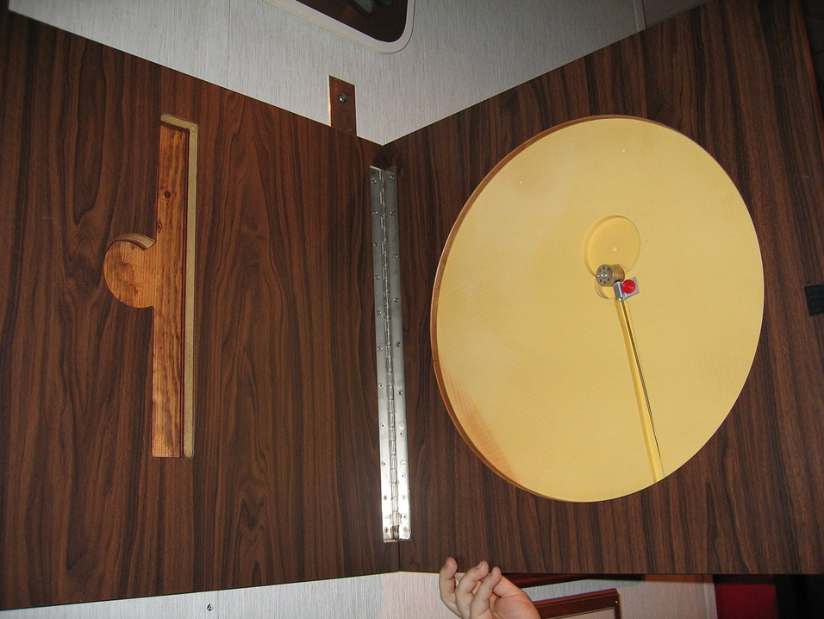
The Great Seal Bug
What do you know regarding the picture presented on the right side of the slide?
It contained a concealed passive device, which is considered a predecessor of radio frequency identification (RFID) technology which was used for eavesdropping.
It was the first covert listening device that utilized passive techniques.
It took the Americans six years to determine its real purpose.
Notes:
But if you review it internally, it was actually the first covert listening device that utilized passive techniques.
It contained a passive device which is considered a predecessor of RFID technology which was used for eavesdropping

Slide 7
The Great Seal Bug
What do you know regarding the picture presented on the right side of the slide?
It contained a concealed passive device, which is considered a predecessor of radio frequency identification (RFID) technology which was used for eavesdropping.
It was the first covert listening device that utilized passive techniques.
It took the Americans six years to determine its real purpose.
It was named “The Great Seal Bug” or “The Thing”
Notes:
You may know it by the name the great seal bug or the thing

Slide 8
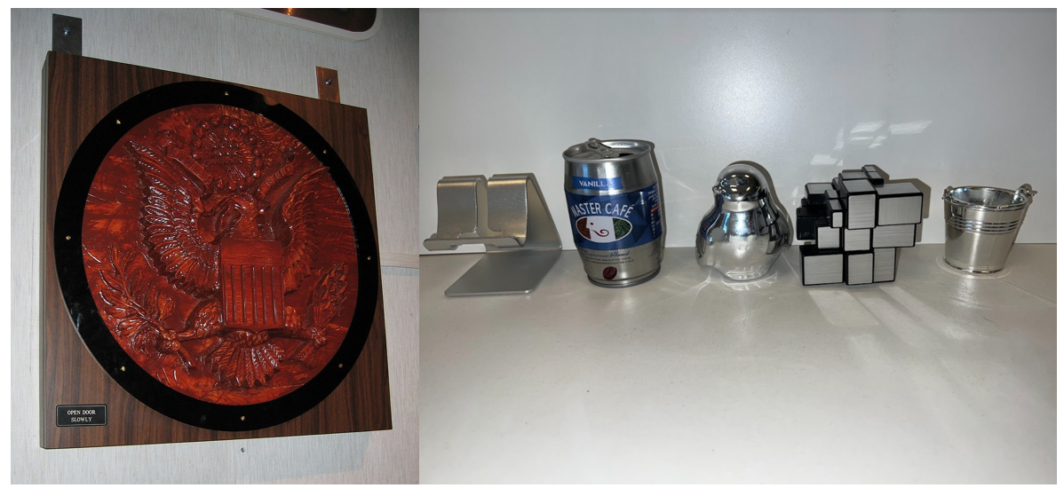
The Great Seal Bug
Can eavesdropper's exploit passive, unaltered, shiny lightweight objects as optical implants for the purpose of speech eavesdropping?
A silver empty beverage can
A silver smartphone stand
SWAG, souvenirs and desktop ornaments
Notes:
Now I want to ask you a question.
Take a look at the picture on the right side of the screen.
You can see there a few unaltered reflective lightweight object.
Do you think that attackers can use these objects as optical implants for the purpose of speech eavesdropping?

Slide 9
The Great Seal Bug
Can eavesdropper's exploit passive, unaltered, shiny lightweight objects as optical implants for the purpose of speech eavesdropping?
A silver empty beverage can
A silver smartphone stand
SWAG, souvenired and desktop ornaments
We name these lightweight shiny object “Little Seal Bugs”
Notes:
So the answer is yes, and I am going to show you how throughout this talk

Slide 10
Related Work
Notes:
Now, lets discuss some eavesdropping related researches

Slide 11
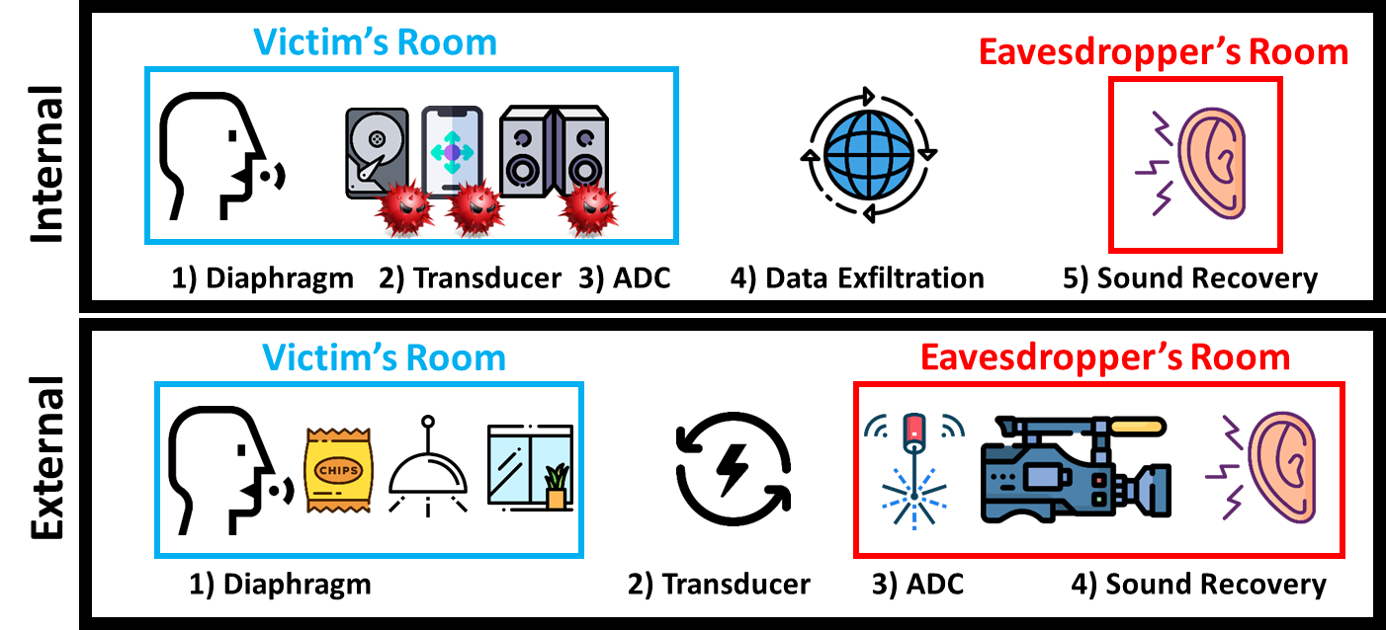
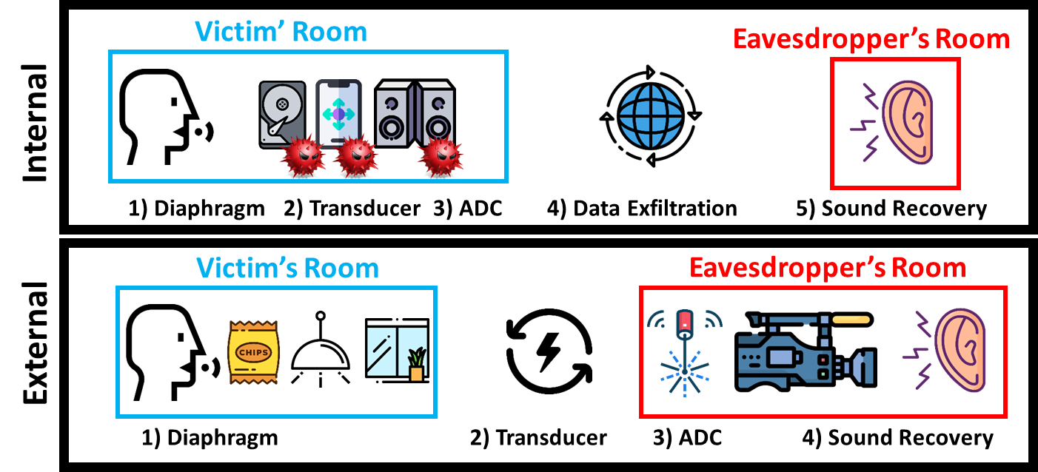
Eavesdropping Related Research
In recent years, the scientific community has suggested various ways to recover sound.
There are two categories of methods:
Internal Methods External Methods
Notes:
First of all, in recent years, the scientific community has offered various ways to recover sound, and these ways are devided to 2 categories- internal and external methods

Slide 12



Internal Methods
Methods that rely on data obtained by a device located in proximity to a victim
Motion Sensors
Gyroscope [1]
Accelerometer [2-4]
Output Devices
Speakers [5]
Vibration Motor [6]
Misc.
Hard Drive [7]
Notes:
Internal methods are methods that obtain data relying on a device located in proximity to the victim
For example, it was demonstrated how data obtained from motion sensors or magnetic data obtained from a hard drives can be used to recover speech.

Slide 13



External Methods
Methods that rely on data obtained by a device that is not located near a victim
Laser Microphone [8]
Visual Microphone [9]
Lamphone
Notes:
The other category is external methods. These methods rely on data obtained by a device that is not located near the victim.
The primary methods under this topic is the laser microphone, which utilize a laser transceiver to recover speech, visual microphone which uses a high frequency video camera to analyze the vibrations of objects and recover speech, for example – a bag of chips.
The last method in this category is lamphone, which utilize a photodiode to recover speech by analyzing lightbulb’s respond to sound

Slide 14




Summary of Related Work
Internal Methods
External Methods
Motion Sensors Output Devices Misc.
Laser Microphone
Lamphone
Visual Microphone
From the eavesdropper’s perspective, each method is limited by one of the following:
Relies on a remotely controlled device - eavesdroppers must compromise a device with a malware
Active - which makes it easier for the victim to detect the use of the method
Cannot be applied in real-time - because it requires heavy computational resources
Relies on an uncommon object in the victim’s room
Notes:
In general, if I have to summarize this section of related work, each of the methods I presented you today is limited by at least one of the following limitations-
It relies on a compromised device
Its active, which makes it easier to detect
It can’t be applied in real time
Or it relies on an uncommon object in the victim’s room

Slide 15
Threat Model
Notes:
Now let’s discuss the threat model of The Little Seal Bug attack

Slide 16
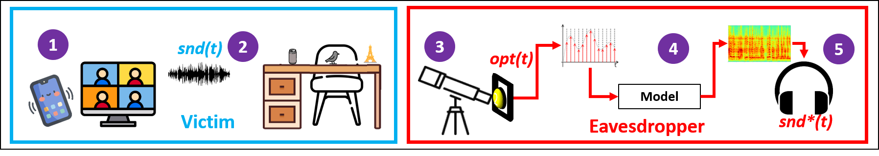
The Little Seal Bug Attacks
We assume that a victim makes the call/attends the meeting from an office/room that contains a little seal bug, in the form of a lightweight shiny object.
The sound 𝑠𝑛𝑑(𝑡) from the victim’s conversation creates fluctuations on the surface of a lightweight reflective object (e.g., an empty iced coffee can, desk ornaments) placed on a desk.
Notes:
First of all, We assume that a victim makes the call/attends the meeting from an office/room that contains a little seal bug, in the form of a lightweight shiny object.
Second, we will assume that The sound 𝑠𝑛𝑑(𝑡) from the victim’s conversation creates fluctuations on the surface of a lightweight reflective object (e.g., an empty iced coffee can, desk ornaments) placed on a desk.

Slide 17
The Little Seal Bug Attacks
The eavesdropper directs a photodiode at the lightweight shiny object via a telescope.
The optical signal 𝑜𝑝𝑡(𝑡) is sampled from the photodiode via an ADC.
An algorithm is used to recover the acoustic signal 𝑠𝑛𝑑∗(𝑡).
Notes:
In addition, we will assume that a eavesdropper directs a photodiode at the lightweight shiny object via a telescope
The optical signal from the photodiode is sampled via an analog to digital converter
After that, an algorithm is used to recover the acoustic signal

Slide 18
The Little Seal Bug Attacks
From an eavesdropper’s perspective, The Little Seal Bug’s threat model is
External
Passive
Can be applied in real-time.
Based on more commonly used objects (e.g., a smartphone stand, an empty beverage can, desktop ornaments, etc).
Notes:
From an eavesdropper’s perspective, this threat model is external, its passive, it can be applied in real time, and it is based on commonly used objects.

Slide 19
Analysis
Notes:
Let’s analyze the physical phenomenon of the attack

Slide 20
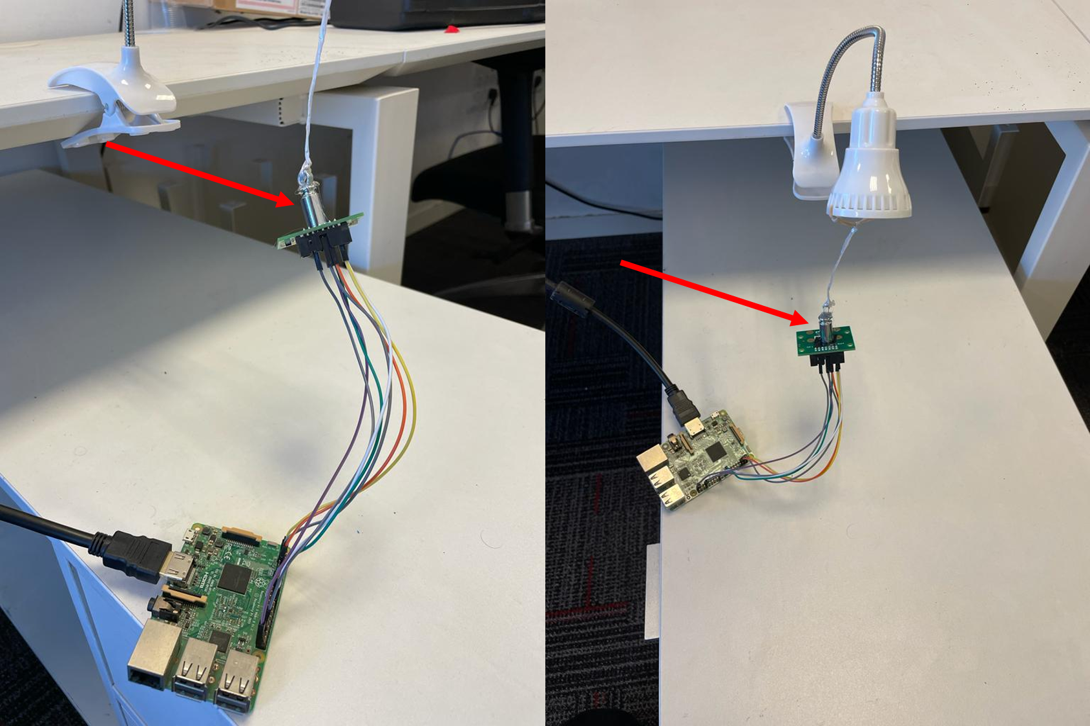
Measuring reflective object’s Vibrations
Experiment
We took a shiny weight (50 grams)
We connected the weight to a gyroscope that was connected to Raspberry Pi 3.
We played a frequency scan (200-1500 Hz) from speakers placed 10 cm from the weight (at 75 dB).
Notes:
The first experiment we did is to measure the vibration of reflective objects.
We took a 50 grams shiny weight, and connected it to a gyroscope.
We played a frequency scan from speakers placed 10 cm from the weight at 75 decibels

Slide 21
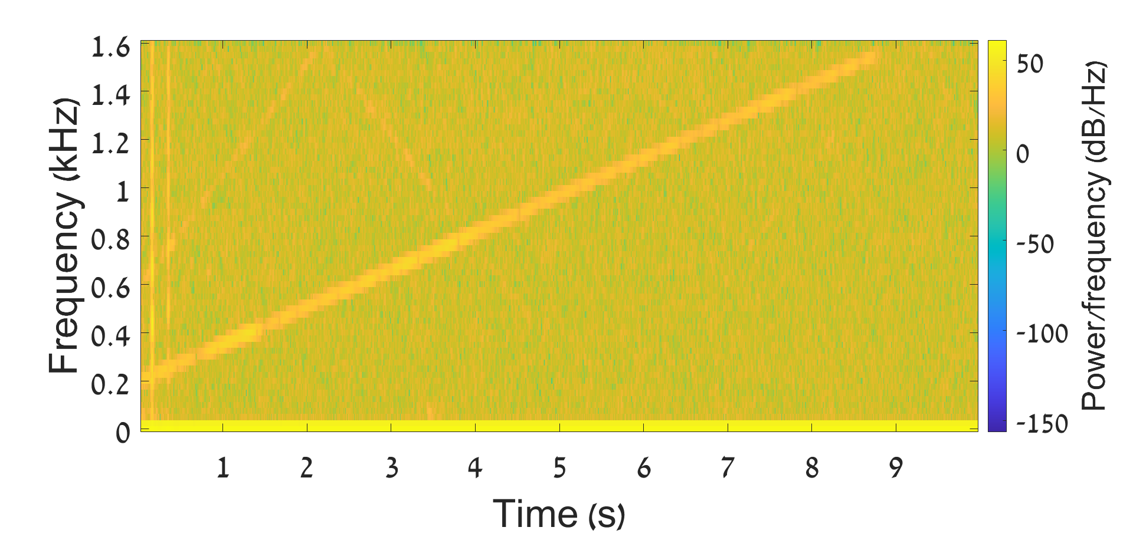
Measuring reflective object’s Vibrations
Results
The figure presents a spectrogram extracted from the measurements obtained by the gyroscope.
As can be seen from the spectrogram, the weight vibrates based on the nearby sound.
Notes:
The results were satisfying. We saw that the weight vibrates based on the nearby sound, as can be seen in the spectrogram in the right side.

Slide 22
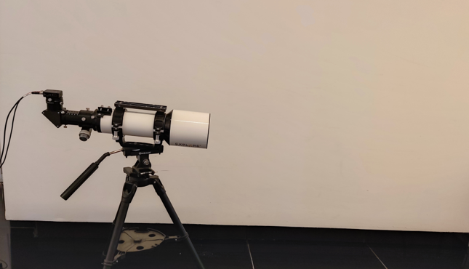
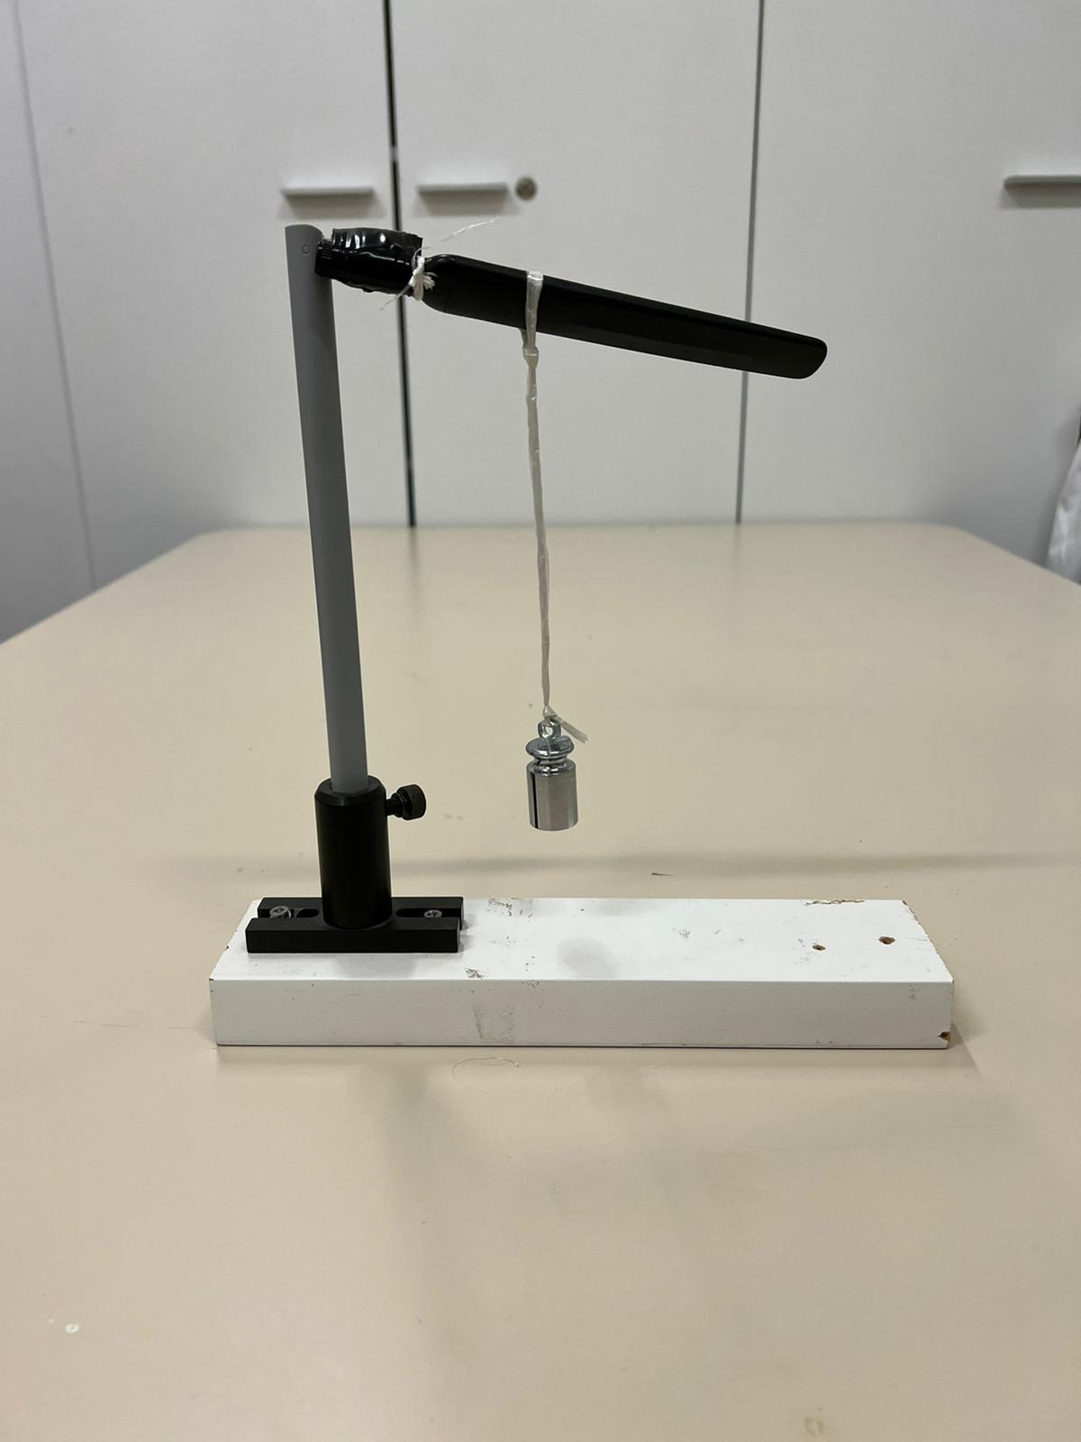
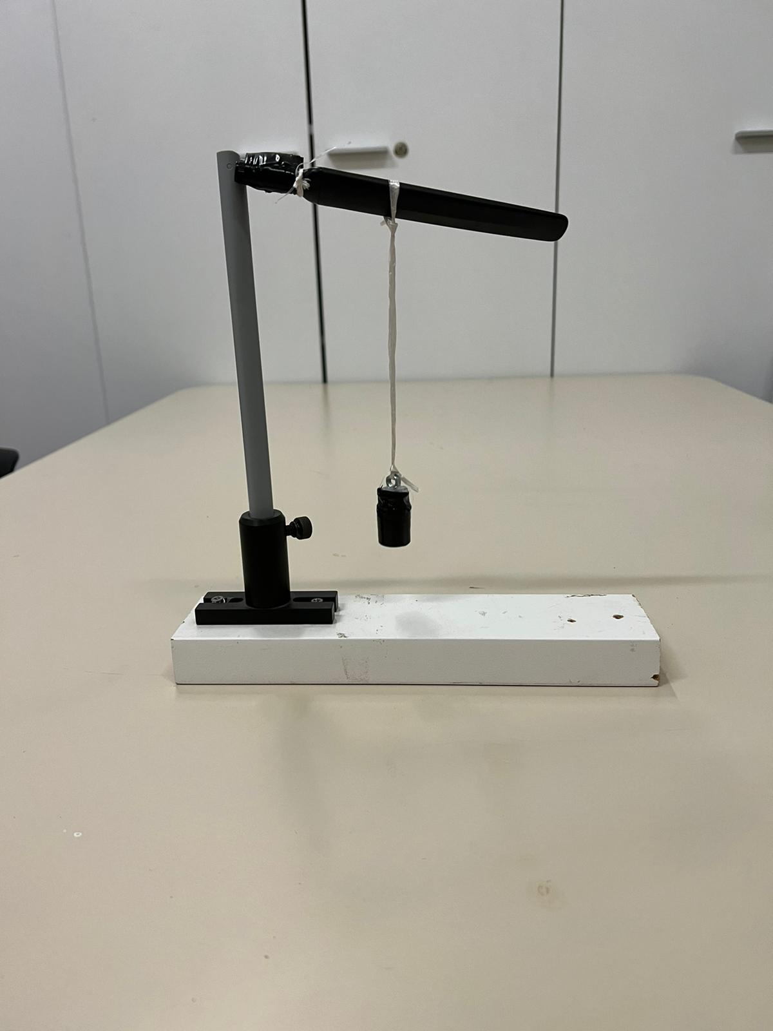

Analyzing light reflected from the object
Experiment
We directed a telescope at the weight.
We mounted a photodiode (the Thorlabs PDA100A2) to the telescope and used ADC to sample it.
We played an audio file of a frequency scan (100-2000 Hz) via speakers which were placed 10 cm from the weight (at 75 dB).
We obtained the optical signal via the photodiode when the (1) lights in the room were on, (2) weight was covered with black tape, and (3) the lights in the room were off.
Lights in the room were on
Weight is covered with black tape
Lights in the room were off
Notes:
Next, we wanted to analyze the light reflected from the weight.
We used a telescope directed on the weight, and we mounted a photodiode on it. We sampled the photodiode with an ADC, played a frequency scan in the same settings as in the previous experiment.
We obtained the optical signal from the photodiode 3 times. Once when the lights in the room were on, once when the weight was covered with black tape, and once when the lights in the room were off

Slide 23
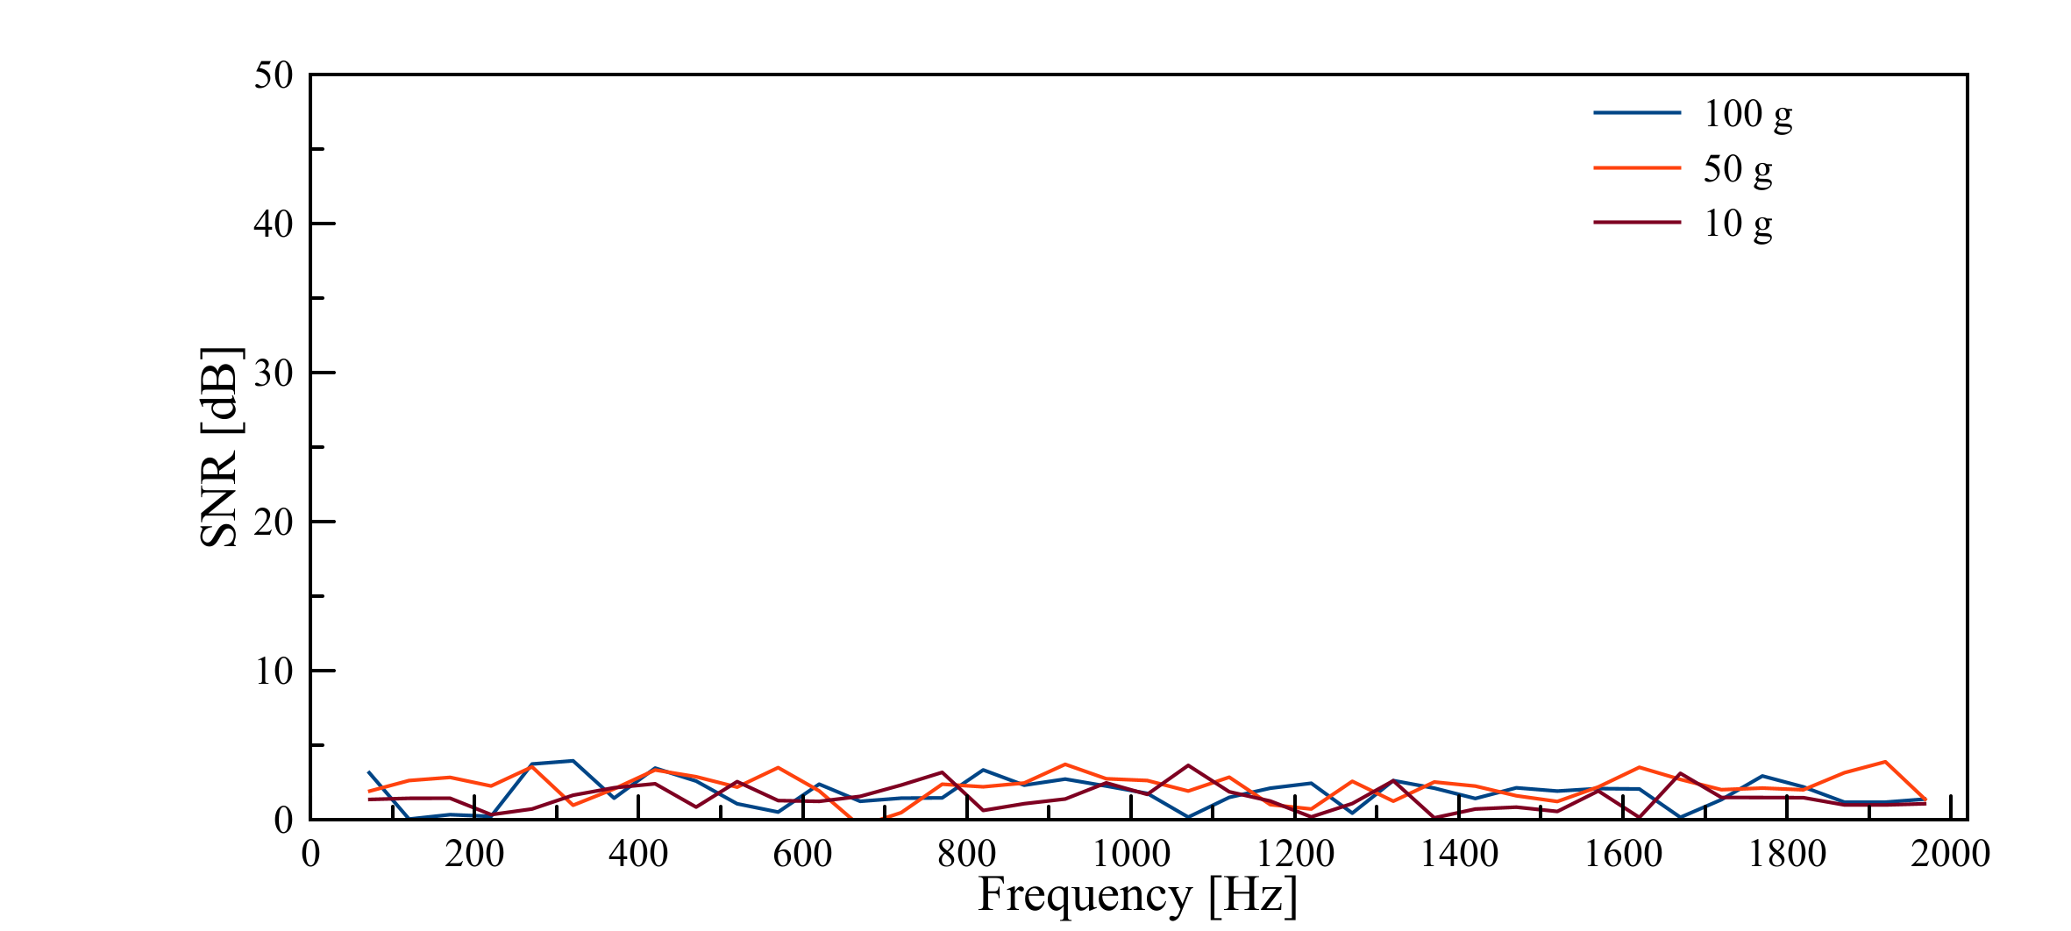
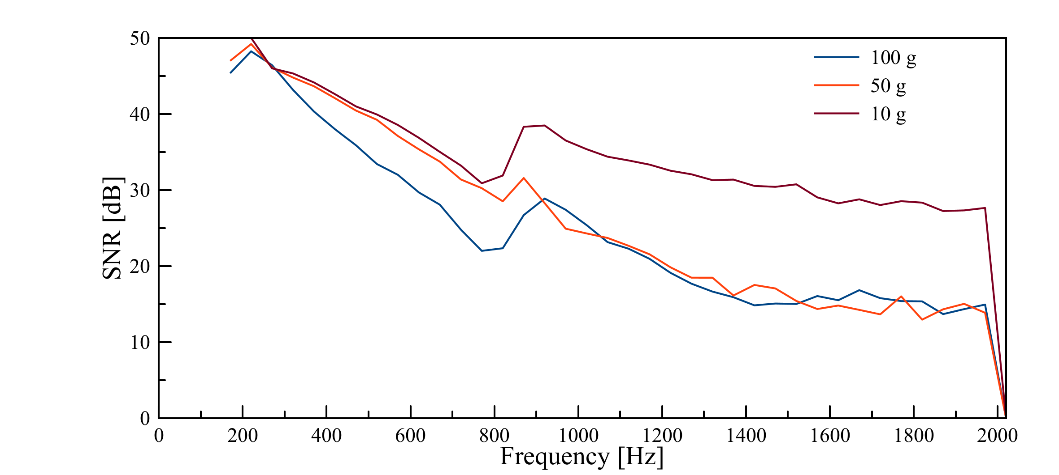
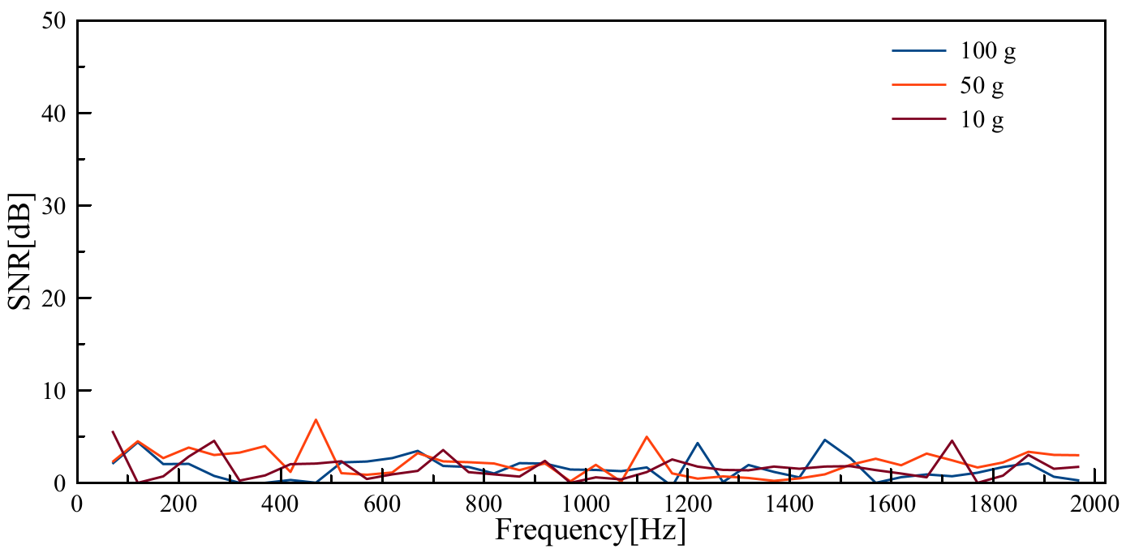
Analyzing light reflected from the object
Results
We calculated the SNR obtained from the optical measurements
The sound that was played near the weight can be recovered only when the lights are on and the weight reflects light (does not covered in black tape)
A risk of speech recovery to a subject exists only if lights are on and a nearby object reflects light. If one of these conditions is not satisfied, sound cannot be recovered.
Notes:
The results were as expected- after calculating the SNR from the optical measurements we saw that nearby sounds can be recovered only when lights are on and the object reflects light.

Slide 24
Isolating the sound from the optical signal
Notes:
Now lets discuss how to isolate sound from the optical signal

Slide 25
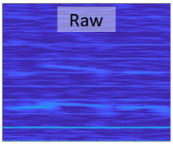
Isolating the sound from the optical signal
We recover speech using the following steps:
Notes:
After we get the raw signal, we follow the following steps

Slide 26
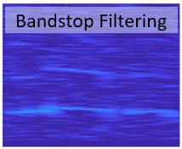
Isolating the sound from the optical signal
We recover speech using the following steps:
Filtering Side Effects
The optical signal consists of side effects that are not the result of the sound played, e.g., the harmonics of 100 Hz (200 Hz, 300 Hz, etc.). We filter these frequencies using bandstop filters.
Notes:
We first filter side effects that aren’t the result of the sound played in the room, for example, harmonics of 100Hz. We use bandstop filters to do so

Slide 27
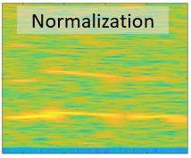
Isolating the sound from the optical signal
We recover speech using the following steps:
Filtering Side Effects
Normalizing
We enhance the speech signal by normalizing the values of 𝑜𝑝𝑡 (𝑡) to the range of [-1,1].
Notes:
Then, we enhance the speech by normalizing the values of the signal.

Slide 28
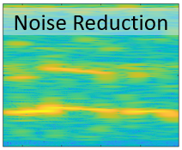
Isolating the sound from the optical signal
We recover speech using the following steps:
Filtering Side Effects
Normalizing
Noise Reduction We reduce the noise by applying spectral subtraction, an adaptive technique used to denoise single-channel speech without any prior knowledge/assumptions on the measurements’ distribution
Notes:
Then we use spectral subtraction algorithm to denoise the signal

Slide 29
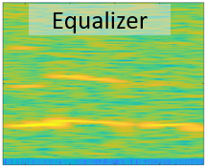
Isolating the sound from the optical signal
We recover speech using the following steps:
Filtering Side Effects
Normalizing
Noise Reduction
Equalizer
We use an equalizer to amplify the response of weak frequencies.
Notes:
After that we use an equalizer to amplify the response of weak frequencies

Slide 30
Evaluation
in a Real Setup
Notes:
Now, let’s the evaluation of our attack in comparison to other attacks

Slide 31
Comparison to Visual Microphone
We evaluated The Little Seal Bug Attack under the same experimental setup of Visual Microphone:
We placed speakers 5 cm from the reflective objects
The volume of the speakers was 95 dB
The eavesdropping equipment was placed 2.5m from the objects
We then played the same 6 sentences from the TIMIT repository recovered by the visual microphone
Notes:
First, we evaluated our attack under the same experimental setup of Visual microphone
We placed the speakers 5 cm from the reflective objects, while the volume was 95 dB, which is very loud.
We place the eavesdropping equipment 2.5m from the objects.
Then, we played the same sentences from the TIMIT repository that were used by visual microphone

Slide 32
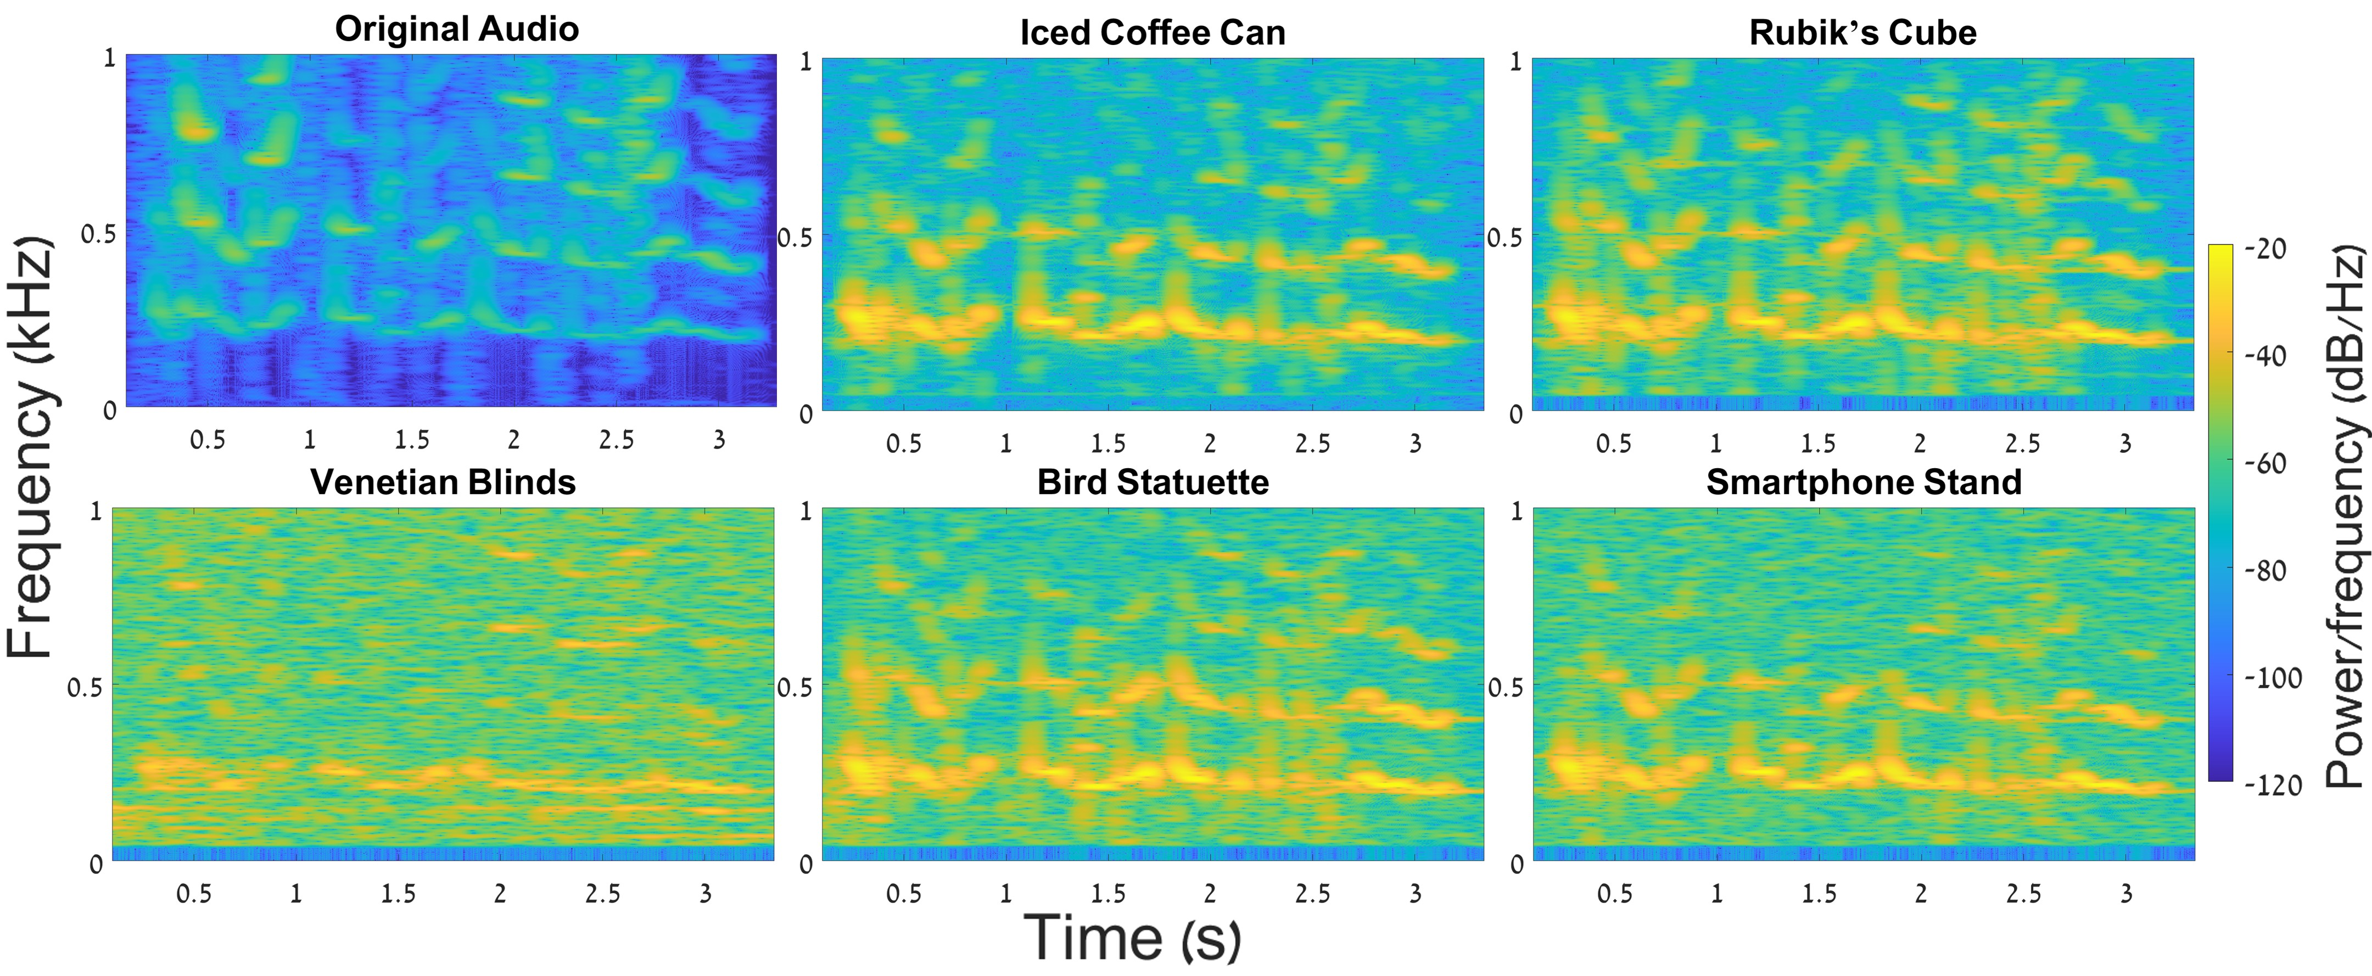
Comparison to Visual Microphone
The spectrogram of the original sentence and the recovered sentence "She had your dark suit in greasy wash water all year" from various objects
And now we will proceed to listen to the recordings of the recovered sound
Notes:
Here you can see the spectrograms that were obtained from the original sentence, and the optical measurements of various objects that we used in this experiement. You can obviously see that the spectrogram of the original audio is at much higher quality.
However, I want to prove to you that the signals that were recovered are still in good quality, and you will be able to understand the content out of the recovered sound.

Slide 33
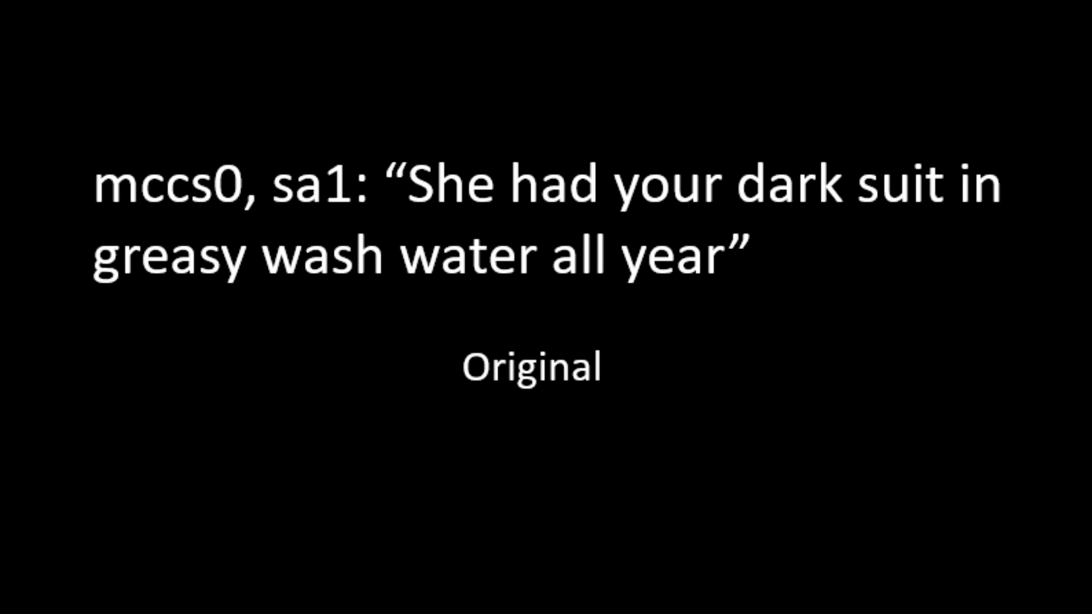

Slide 34
Comparison to Lamphone
We evaluated The Little Seal Bug Attack under the same experimental setup as Lamphone.
Quick reminder:
Lamphone was presented in 2020 by our group at BlackHat USA.
We demonstrated speech recovery by analyzing the vibrations of a hanging light bulb using a photodiode
Notes:
next, we evaluate our attack under the same experimental setup as lamphone.
Just as a reminder, lamphone was presented in 2022 by our group in usenix.
We demonstrated speech recovery by analyzing the vibrations of a hanging lightbulb, using a photodiode

Slide 35
Comparison to Lamphone
We replicated the experimental setup used in the Lamphone study as follows:
We placed the eavesdropping equipment at various distances (15,25,35 meters) from three objects used in this experiment.
The speakers were placed at a distance of 25 cm from the reflective objects.
We played a statement made by former President Donald Trump via the speakers at the volume level of a virtual meeting (75dB).
Notes:
The experimental setup was replicated as follows
We placed the eavesdropping equipment at various distances – 15m, 25m, and 35m. The speakers were at a distance of 25 cm from the reflective object
We played a statement made by former President Donald Trump via the speakers at the volume level of a virtual meeting (75dB).

Slide 36
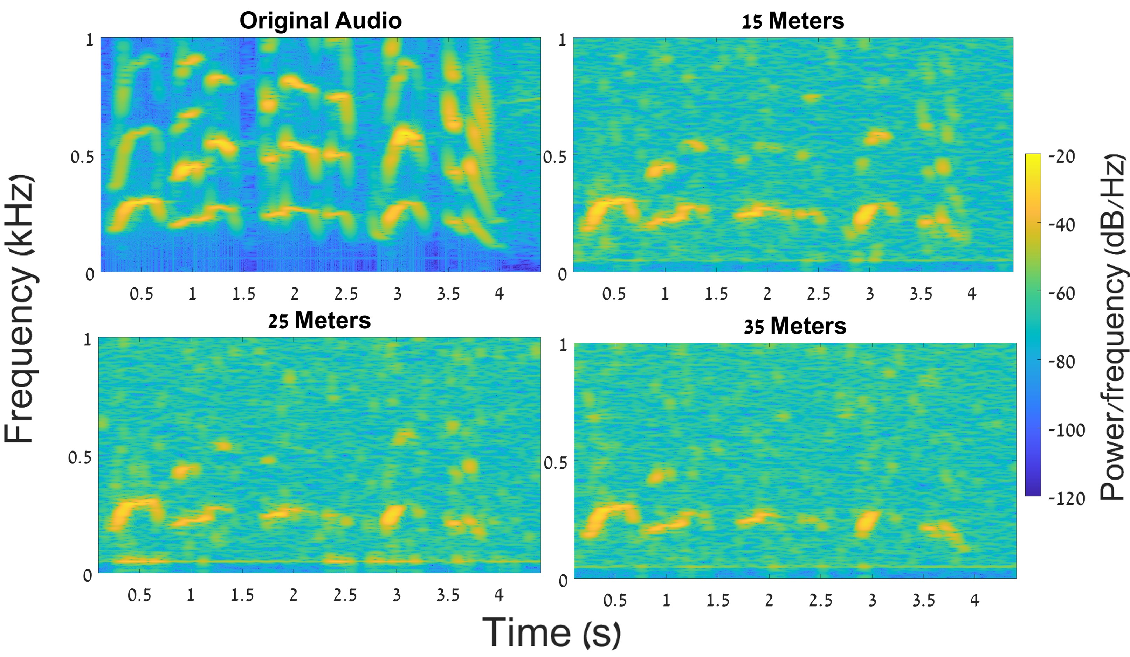
Comparison to Lamphone
The spectrogram of the original statement and the recovered statement from the Rubik’s cube from various distances:
And now we will proceed to listen to the recordings of the recovered sound
Notes:
Here we can see the spectrograms obtained out of the optical signal recovered from a rubik’s cube from various distances. We can see that the quality goes down as the distance goes up, as expected. Let’s hear the recovered audios

Slide 37


Slide 38
Takeaways
Notes:
Now, let’s review some of the takeaways for this talk

Slide 39
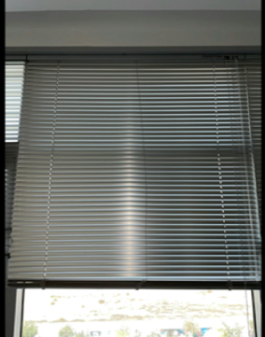
Takeaways
Takeaway 1: Many shiny lightweight objects can serve as optical implants that can be exploited by eavesdroppers to recover sound.
Notes:
The primary takeaway of this talk is that as you can understand, many shiny lightweight objects can serve as optical implants, and might be exploited by eavesdroppers to recover sound. Most of the cases those are completely innocent objects, and in some cases, for example, venetian blinds, those objects should increase privacy, but can be exploited as the complete opposite

Slide 40
Takeaways
The area of optical speech eavesdropping has advanced significantly in the last seven years:
Visual Microphone (high-frequency video camera)– 2014
Lamphone (photodiode) – 2020
LidarPhone (LiDAR)– 2021
The Glowworm Attack (photodiode) - 2021
The Little Seal Bug (photodiode)– 2022
Takeaway 2: We expect that more optical eavesdropping methods that rely on optical sensors will be demonstrated in the next few years.
Notes:
The second takeaway is that that interestingly, the area of speech eavesdropping has advanced significantly in the last nine years- ever since visual microphone showed how to eavesdrop on speech using high frequency cameras to analyze vibrations, and other attacks since then- lamphone, LidarPhone, The Glowworm Attack, and today, The little seal bug.
We expect that more optical eavesdropping methods that rely on optical sensors will be demonstrated in the next few years.

Slide 41
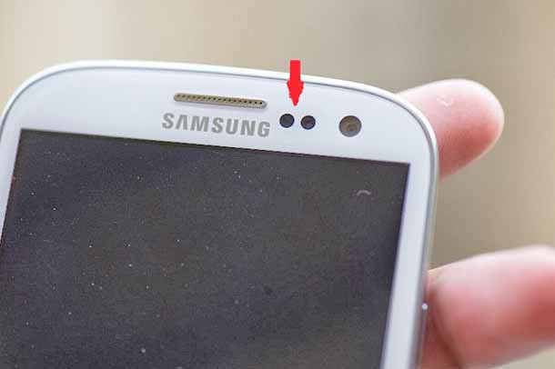
Takeaways
Fact 1: Photodetectors are integrated into most smartphones nowadays.
Fact 2: Smartphone manufacturers continue to increase the smartphone sampling rate (in some Android devices, the system supports a sampling rate of 500 Hz).
Fact 3: Obtaining data from the photodetector does not require a user’s permission.
Takeaway 3: We might see an implementation of a new type of malware and compromised applications for speech eavesdropping via a smartphone’s light sensor in the near future.
Notes:
For the next takeaway, there are 3 interesting facts that id like you to take into account.
The first one- photodiodes are integrated into most smartphones nowdays
Second, smartphones manufacturers continue to increase the smartphone sampling rate
Third, obtaining data from those sensors does not require user’s permission.
All of these facts alone aren’t very important or dangerous, but combining them together, we might see an implementation of a new type of malware, and compromised apps for speech eavesdropping via a smartphone’s light sensor in the near future.

Slide 42
Thank you for attending this talk!
Questions?
www.nassiben.com/little-seal-bug

